Slide 1
Section 3: Tabling with ARDs: {tfrmt} and {gtsummary}

Slide 2
Great, we have ARD’s, but you said we’d have tables

Slide 3
Call back to Daniel’s tabling package visual to intro that we are going to talk about tfrmt and gtsummary

Slide 4


Creating tables using ARDs in R
{tfrmt} Package:
Applies display metadata to analysis results datasets
https://gsk-biostatistics.github.io/tfrmt/
{tfrmtbuilder} Package:
Interactive interface to {tfrmt}
https://gsk-biostatistics.github.io/tfrmtbuilder/

Slide 5

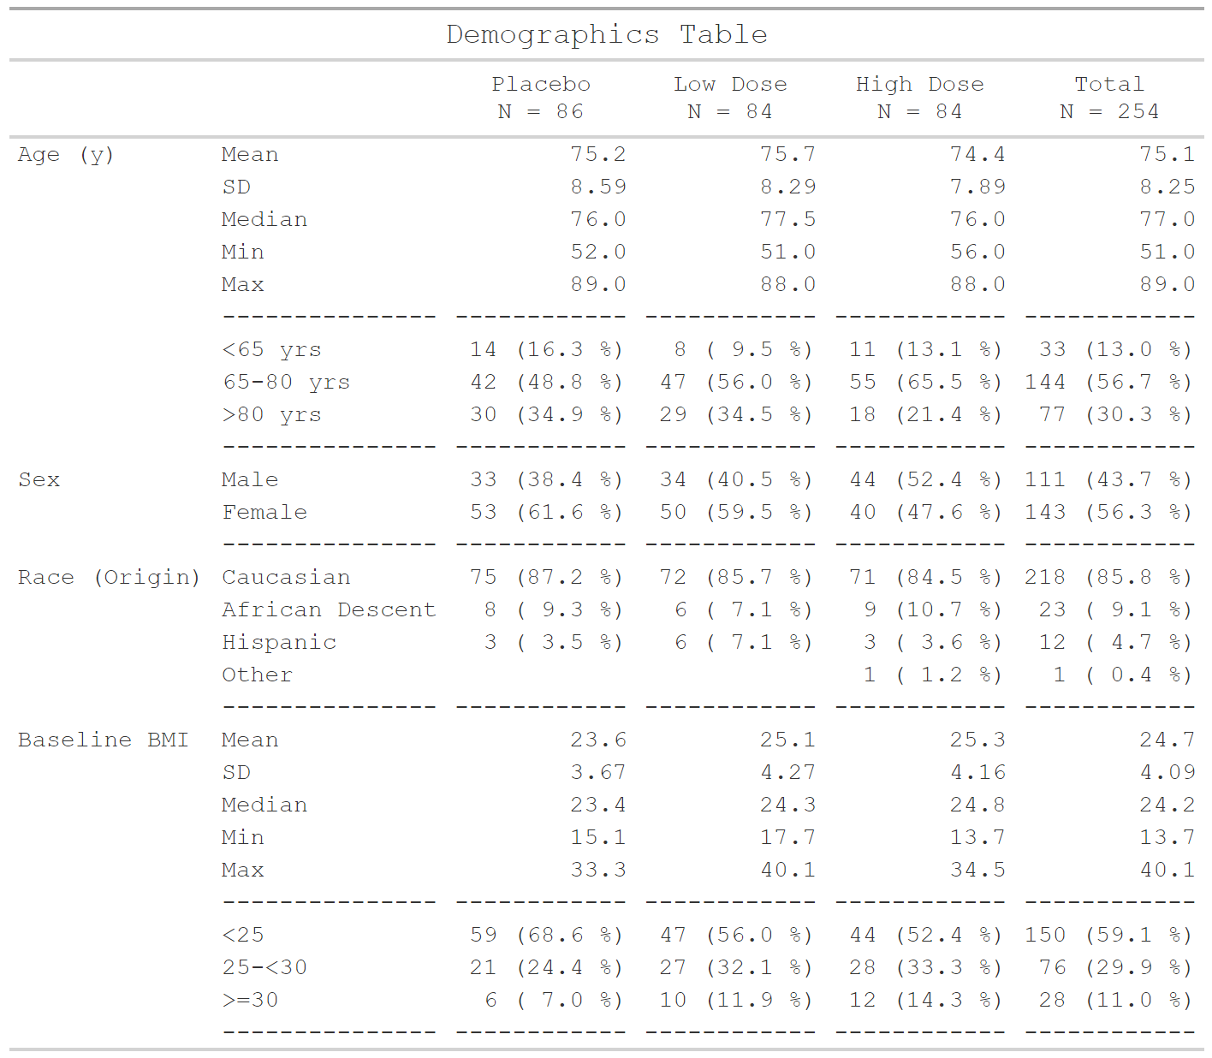
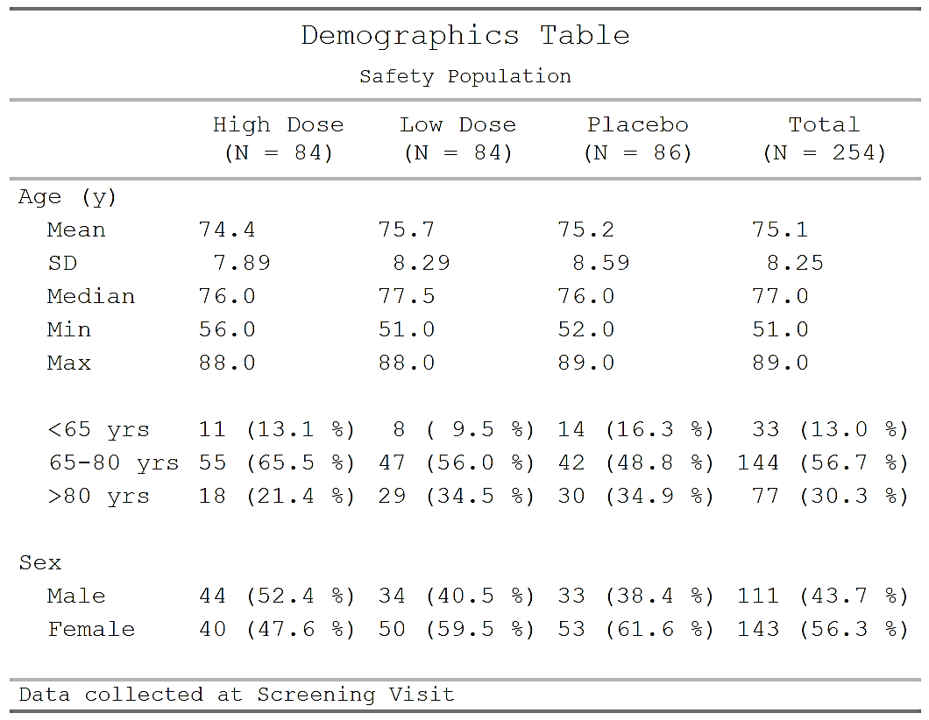

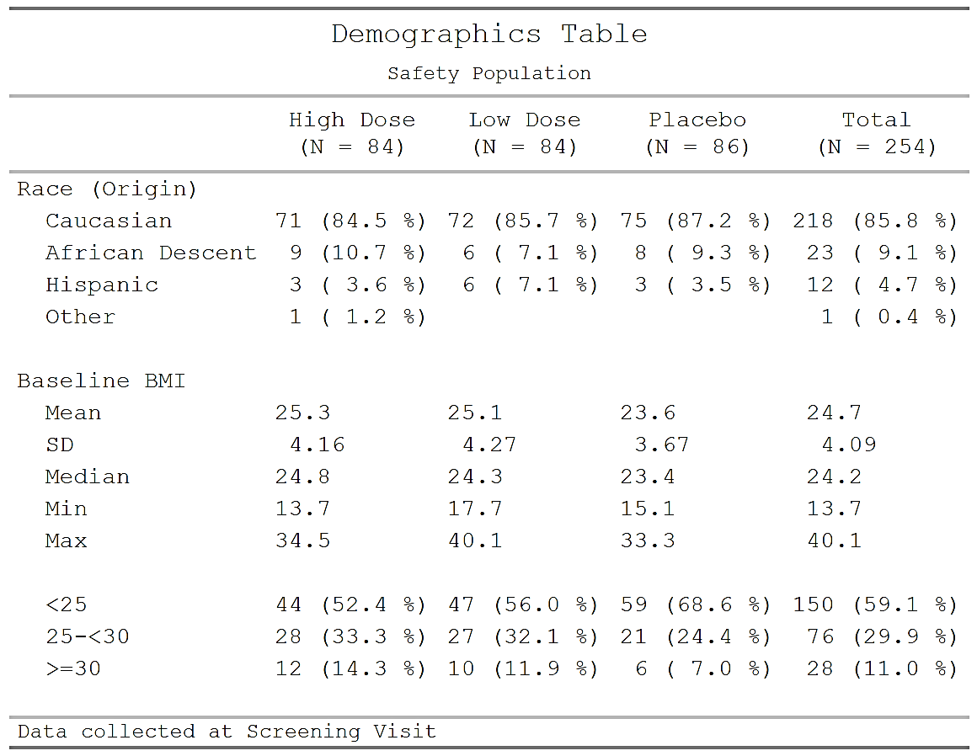



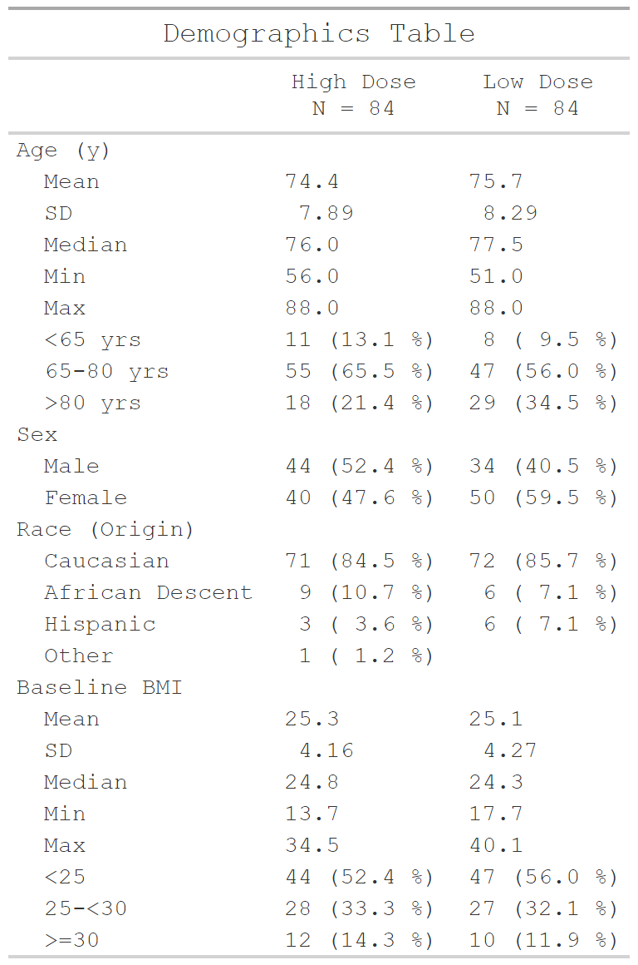




Source
Publication
Results
Presentation
Study Report

Slide 6


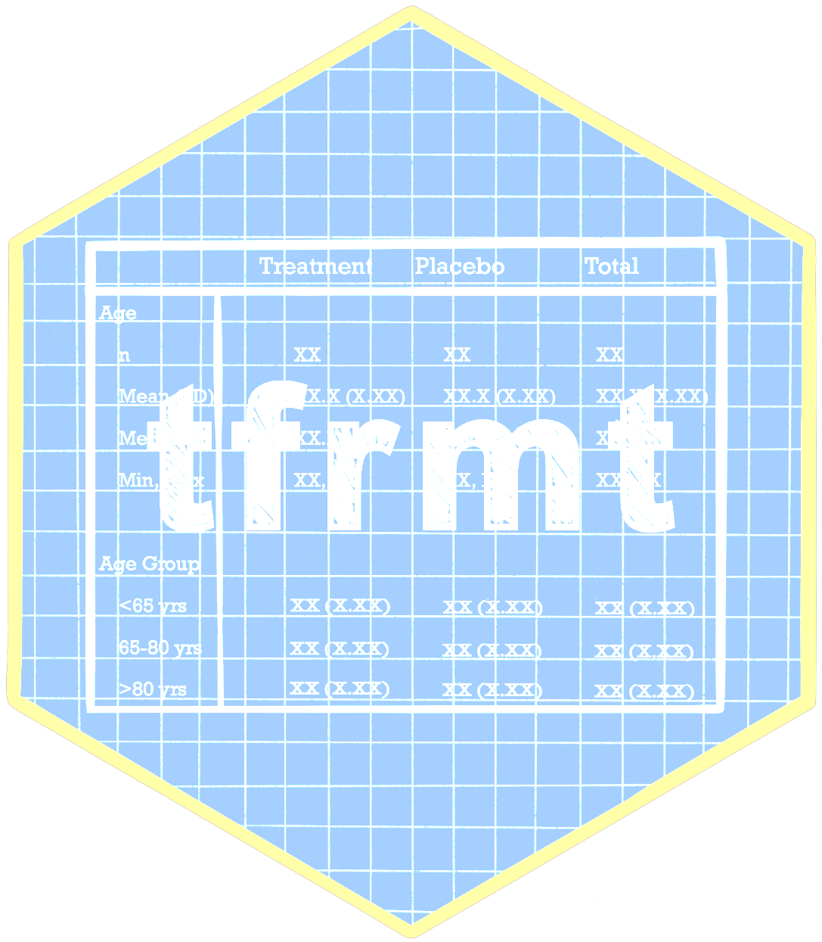

Source
Publication
Results
Presentation
Study Report

Slide 7
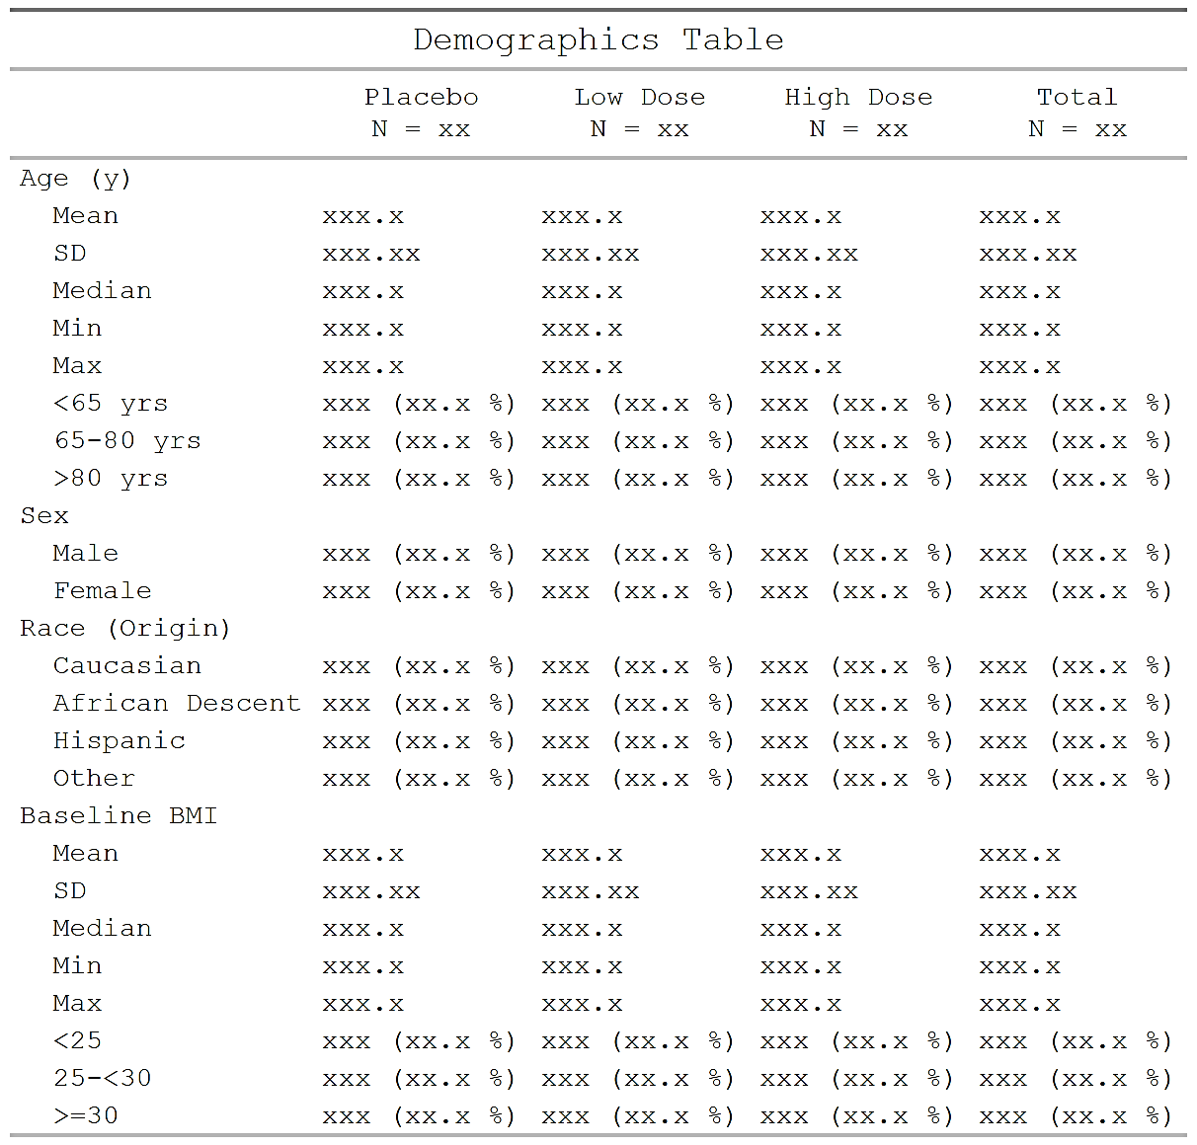
Mock display during study planning

Slide 8
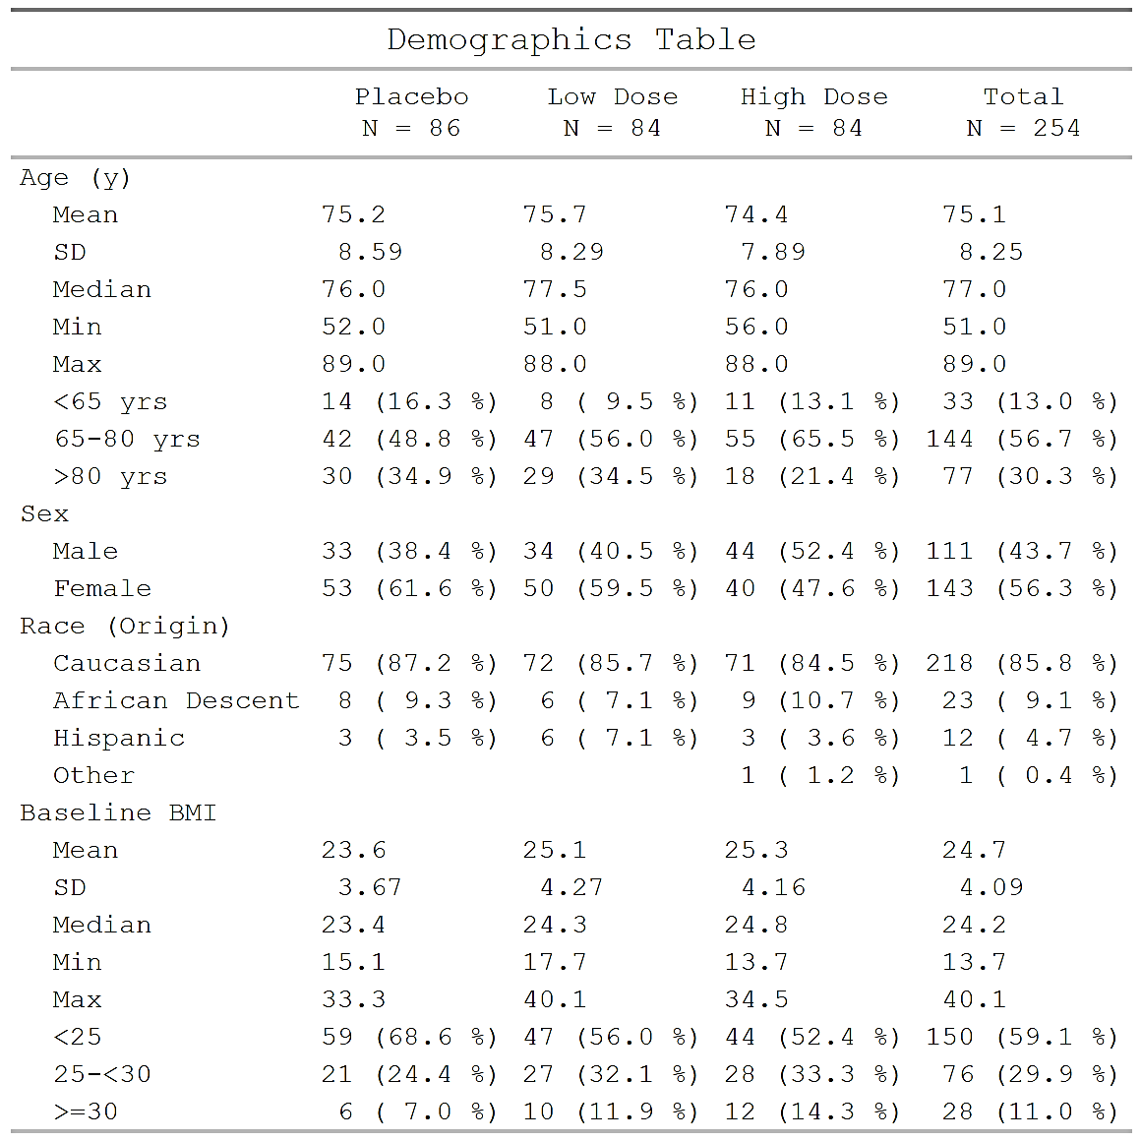
Add the data when available
+ ARD

Slide 9

Easy customizations
+ ARD
Page 1 of 2
Page 2 of 2

Slide 10
Tables parts
 |  | Placebo (N = XX) | Treatment (N = XX) | Total (N = XX)
Age (y) | n | XX | XX | XX
 | Mean (sd) | XX.X(XX.XX) | XX.X(XX.XX) | XX.X(XX.XX)
 | Median | XX.X | XX.X | XX.X
 | Min, Max | XX,XX | XX,XX | XX,XX
 | <65 yrs | XX (XX.X%) | XX (XX.X%) | XX (XX.X%)
 | 65-80 yrs | XX (XX.X%) | XX (XX.X%) | XX (XX.X%)
 | >80 yrs | XX (XX.X%) | XX (XX.X%) | XX (XX.X%)
Sex | n | XX | XX | XX
 | Male | XX (XX.X%) | XX (XX.X%) | XX (XX.X%)
 | Female | XX (XX.X%) | XX (XX.X%) | XX (XX.X%)
Columns
Row groups
Labels and groups
Table body
Notes:
How can we break a table down into component parts

Slide 11
Tables parts
 |  | Placebo (N = XX) | Treatment (N = XX) | Total (N = XX)
Age (y) | n | XX | XX | XX
 | Mean (sd) | XX.X(XX.XX) | XX.X(XX.XX) | XX.X(XX.XX)
 | Median | XX.X | XX.X | XX.X
 | Min, Max | XX,XX | XX,XX | XX,XX
 | <65 yrs | XX (XX.X%) | XX (XX.X%) | XX (XX.X%)
 | 65-80 yrs | XX (XX.X%) | XX (XX.X%) | XX (XX.X%)
 | >80 yrs | XX (XX.X%) | XX (XX.X%) | XX (XX.X%)
Sex | n | XX | XX | XX
 | Male | XX (XX.X%) | XX (XX.X%) | XX (XX.X%)
 | Female | XX (XX.X%) | XX (XX.X%) | XX (XX.X%)
tfrmt(…,
group = “var1”,
label = “var2”,
body_plan = body_plan(),
col_plan = col_plan(),
row_grp_plan = row_grp_plan()
)
Notes:
Tfrmt works by letting you set the styling of each component part

Slide 12
tfrmt with Analysis Results Data
Group | Label | Column | Param | Value
Age (y) | n | Placebo | n | 15.00
Age (y) | n | Treatment | n | 13.00
Age (y) | n | Total | n | 28.00
Sex | n | Placebo | n | 14.00
Sex | n | Treatment | n | 13.00
Sex | n | Total | n | 27.00
Age (y) | Mean (sd) | Placebo | mean | 73.56
Age (y) | Mean (sd) | Treatment | mean | 74.231
Age (y) | Mean (sd) | Total | mean | 71.84
Age (y) | Mean (sd) | Placebo | SD | 9.347
Age (y) | Mean (sd) | Treatment | SD | 7.234
Age (y) | Mean (sd) | Total | SD | 8.293
tfrmt(
group = Group,
label = Label,
column = Column,
values = Value,
param = Param,
…
)
 |  | Placebo | Treatment | Total
Age (y) | n | 15 | 13 | 28
 | Mean (sd) | 73.6(9.35) | 74.2(7.23) | 71.8(8.29)
Sex | n | 14 | 13 | 27
 | Male | 8 (57.1%) | 7 (53.8%) | 15 (55.6%)
 | Female | 6 (48.2%) | 6 (46.1%) | 12 (44.4%)
Notes:
Parameters allow you to combine elements and create conditional formatting for values with the same label

Slide 13
Value formatting
body_plan(
frmt_structure(
group_val = ".default",
label_val = ".default",
frmt_combine("{n} ({pct}%)",
n = frmt("X"),
pct = frmt("xx.x")
)
),
frmt_structure(
group_val = ".default",
label_val = "n",
frmt("XX")),
frmt_structure(
group_val = "Age (y)",
label_val = "Mean (sd)",
frmt_combine("{mean}({SD})",
mean = frmt("XX.X"),
SD = frmt("x.xx")
)
)
)
Group | Label | Column | Param | Value
Age (y) | n | Placebo | n | 15.00
Age (y) | n | Treatment | n | 13.00
Age (y) | n | Total | n | 28.00
Sex | n | Placebo | n | 14.00
Sex | n | Treatment | n | 13.00
Sex | n | Total | n | 27.00
Age (y) | Mean (sd) | Placebo | mean | 73.56
Age (y) | Mean (sd) | Treatment | mean | 74.231
Age (y) | Mean (sd) | Total | mean | 71.84
Age (y) | Mean (sd) | Placebo | SD | 9.347
Age (y) | Mean (sd) | Treatment | SD | 7.234
Age (y) | Mean (sd) | Total | SD | 8.293
 |  | Placebo | Treatment | Total
Age (y) | n | 15 | 13 | 28
 | Mean (sd) | 73.6(9.35) | 74.2(7.23) | 71.8(8.29)
Sex | n | 14 | 13 | 27
 | Male | 8 (57.1%) | 7 (53.8%) | 15 (55.6%)
 | Female | 6 (48.2%) | 6 (46.1%) | 12 (44.4%)

Slide 14
Using the tfrmt
tfrmt_ae <-
tfrmt(
group = “AEBODSYS”,
label = “AETERM”,
column = “TRT”,
...
body_plan = body_plan(...),
col_plan = col_plan(...),
...
)
print_to_gt(tfrmt_ae, data_ae)

Slide 15
Saving the tfrmt for future use
tfrmt_demog.json
{
"group": ["rowlbl1", "grp"],
"label": ["rowlbl2"],
"param": ["param"],
"value": ["value"],
"column": ["TRT"],
"title": ["Demographics Table"],
"row_grp_plan": {
"struct_list": [],
"label_loc": {
"location": ["indented"],
"indent": [" "]
}
},
"body_plan": [
{
"group_val": [".default"],
"label_val": [".default"],
"param_val": ["n", "pct"],
"frmt_combine": {
"expression": ["{n} {pct}"],
"frmt_ls": {
"n": {
"frmt": {
tfrmt_to_json()
json_to_tfrmt()

Slide 16

Demo time! Follow along in 01-tfrmt_demo.R
Notes:
Import the demog ARD previously created
Perform some additional manipulation to prepare for tfrmt
Build the tfrmt step-by-step, viewing with print_to_gt() along the way
Set the data mappings
Progressive body_plan
Demo frmt, frmt_combine, frmt_when, as well as the location helpers
Add the big Ns to the column headers
Remove unneeded columns
Add an empty row after every unique group level

Slide 17
Your turn! Open 02-tfrmt-exercise.R Continue making the demographic table using {tfrmt} and {tfrmtbuilder}
Complete the tfrmt table from the demo
Put mean/sd on same line, each with 2 decimal places
Put median/q1/q3 on same line, each with 1 decimal place
Add a footnote for the column header for Placebo
Export files to desktop
Save the tfrmt to json
Save the data to rds
Use tfrmtbuilder to modify the table further
Toggle *off* mock mode
Upload the ARD and JSON files from your desktop
On the `Titles` tab, add a title to the table
On the `Column Plan` tab, rearrange the columns as High Dose, Low Dose, Placebo, Overall
- On the `Page Plan` tab, split the table after group_val="ETHNIC" so it spans 2 pages

Slide 18
Bonus Exercises: 03-tfrmt-bonus.R
Bonus #1: AE Table
Create a tfrmt for the AE ARD previously created created with the following specs (see mock display `data/tfrmt_mock_ae.html`):
SOC (top-level group) and preferred term (nested group) in the rows
treatment spanning over severity in the columns
big Ns in the treatment spanners
(hint: use `tfrmt_n_pct()` template to get a quick-start)
Bonus #2: Mock shell
Create the code to reproduce the mock shell from `data/tfrmt_mock_vs.html` using the sample ARD `mock_data` below
(hint: use `print_mock_gt` to print a table with no values)

Slide 19

Next up!

